Slide 1
Greedy Algorithms
By Muhammad Waqas Sheikh

Slide 2
Optimization Problems
For most optimization problems you want to find, not just a solution, but the best solution.
A greedy algorithm sometimes works well for optimization problems. It works in phases. At each phase:
You take the best you can get right now, without regard for future consequences.
You hope that by choosing a local optimum at each step, you will end up at a global optimum.

Slide 3
Greedy Approach
Like dynamic programming, used to solve optimization problems.
Problems exhibit optimal substructure (like DP).
Problems also exhibit the greedy-choice property.
When we have a choice to make, make the one that looks best right now.
Make a locally optimal choice in hope of getting a globally optimal solution.

Slide 4

Does greedy-choice property lead us to optimize solution?
Greedy algorithms mostly (but not always) fail to find the globally optimal solution because they usually do not operate exhaustively on all the data.

Slide 5
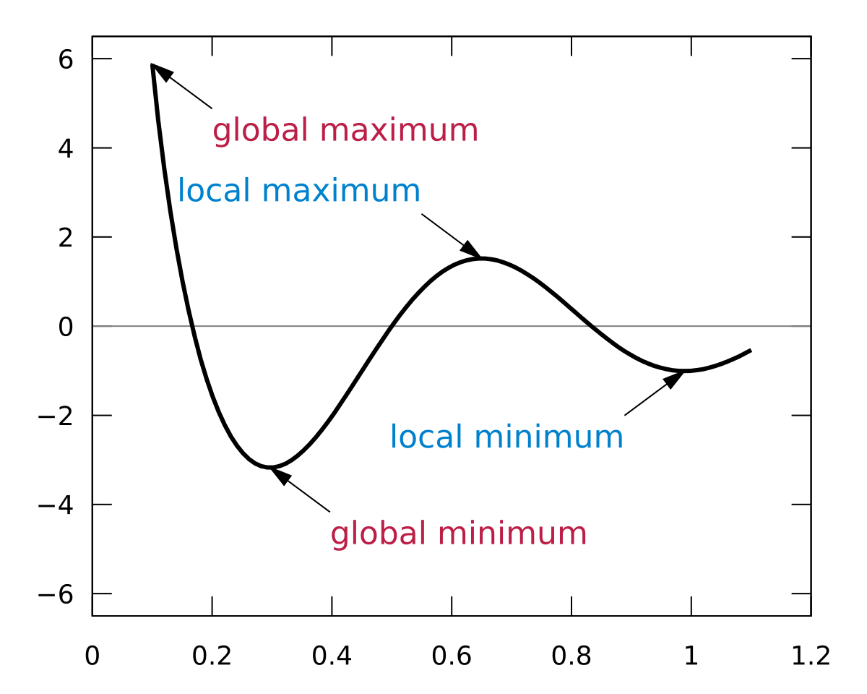

Slide 6
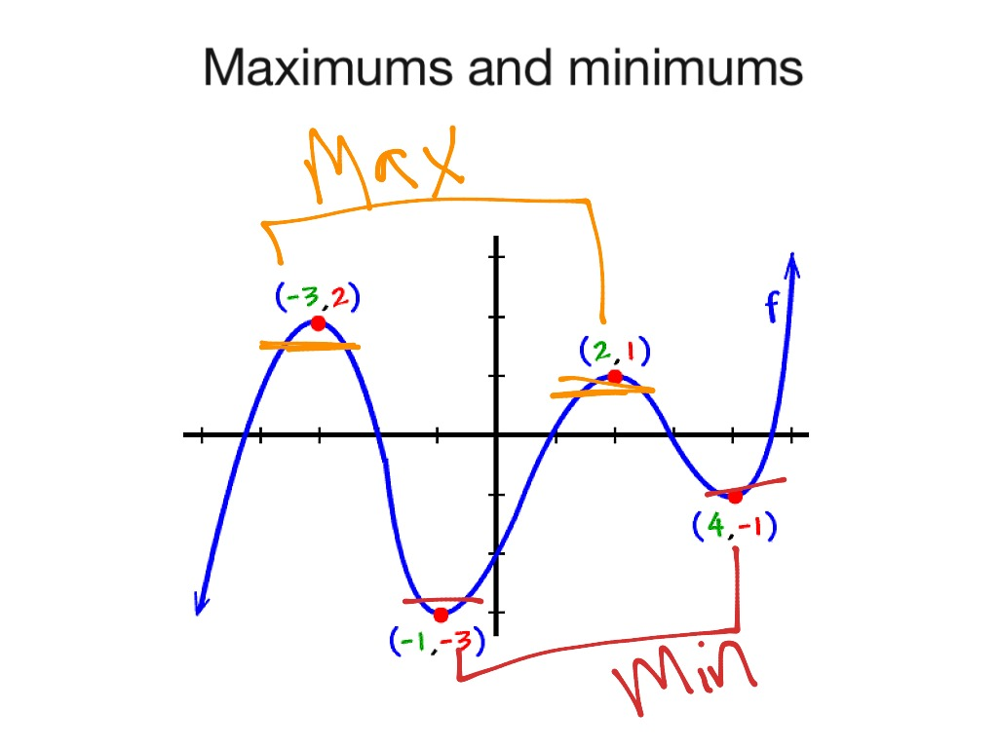

Slide 7
Example: Counting Money
Suppose you want to count out a certain amount of money, using the fewest possible bills and coins
A greedy algorithm to do this would be: At each step, take the largest possible bill or coin that does not overshoot
Example: To make $6.39, you can choose:
a $5 bill
a $1 bill, to make $6
a 25¢ coin, to make $6.25
A 10¢ coin, to make $6.35
four 1¢ coins, to make $6.39
For US money, the greedy algorithm always gives the optimum solution

Slide 8
Greedy Approach Failure
In some (fictional) monetary system, “krons” come in 1 kron, 7 kron, and 10 kron coins
Using a greedy algorithm to count out 15 krons, you would get
A 10 kron piece
Five 1 kron pieces, for a total of 15 krons
This requires six coins
A better solution would be to use two 7 kron pieces and one 1 kron piece
This only requires three coins
The greedy algorithm results in a solution, but not in an optimal solution

Slide 9
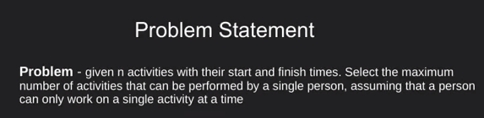
Activity Selection

Slide 10
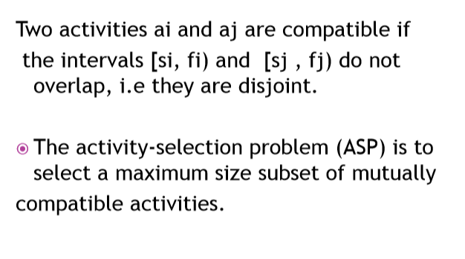
Compatible Activities

Slide 11
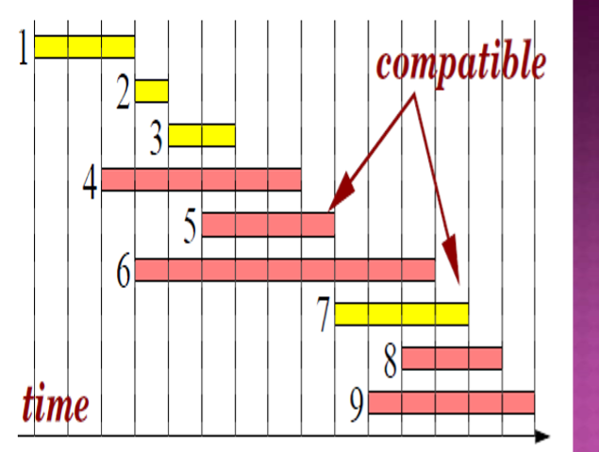

Slide 12
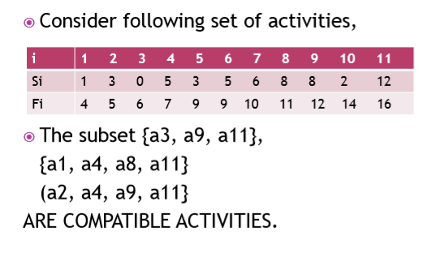

Slide 13
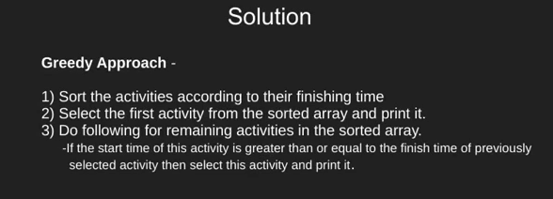
Solution

Slide 14
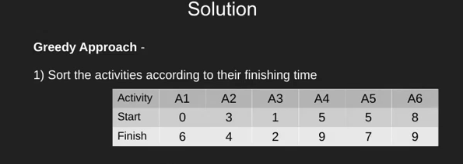

Slide 15
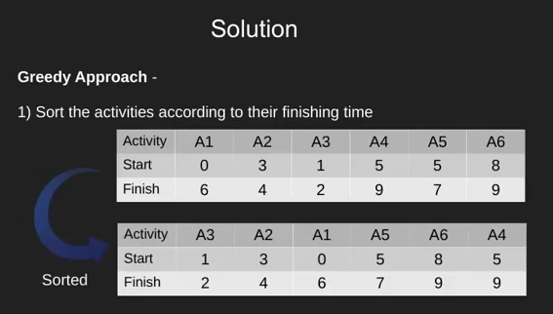
0

Slide 16
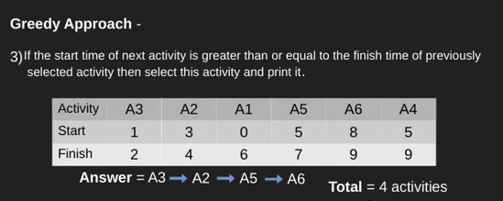
0

Slide 17
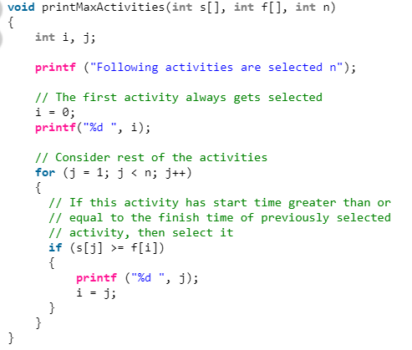

Slide 18
